Slide 1
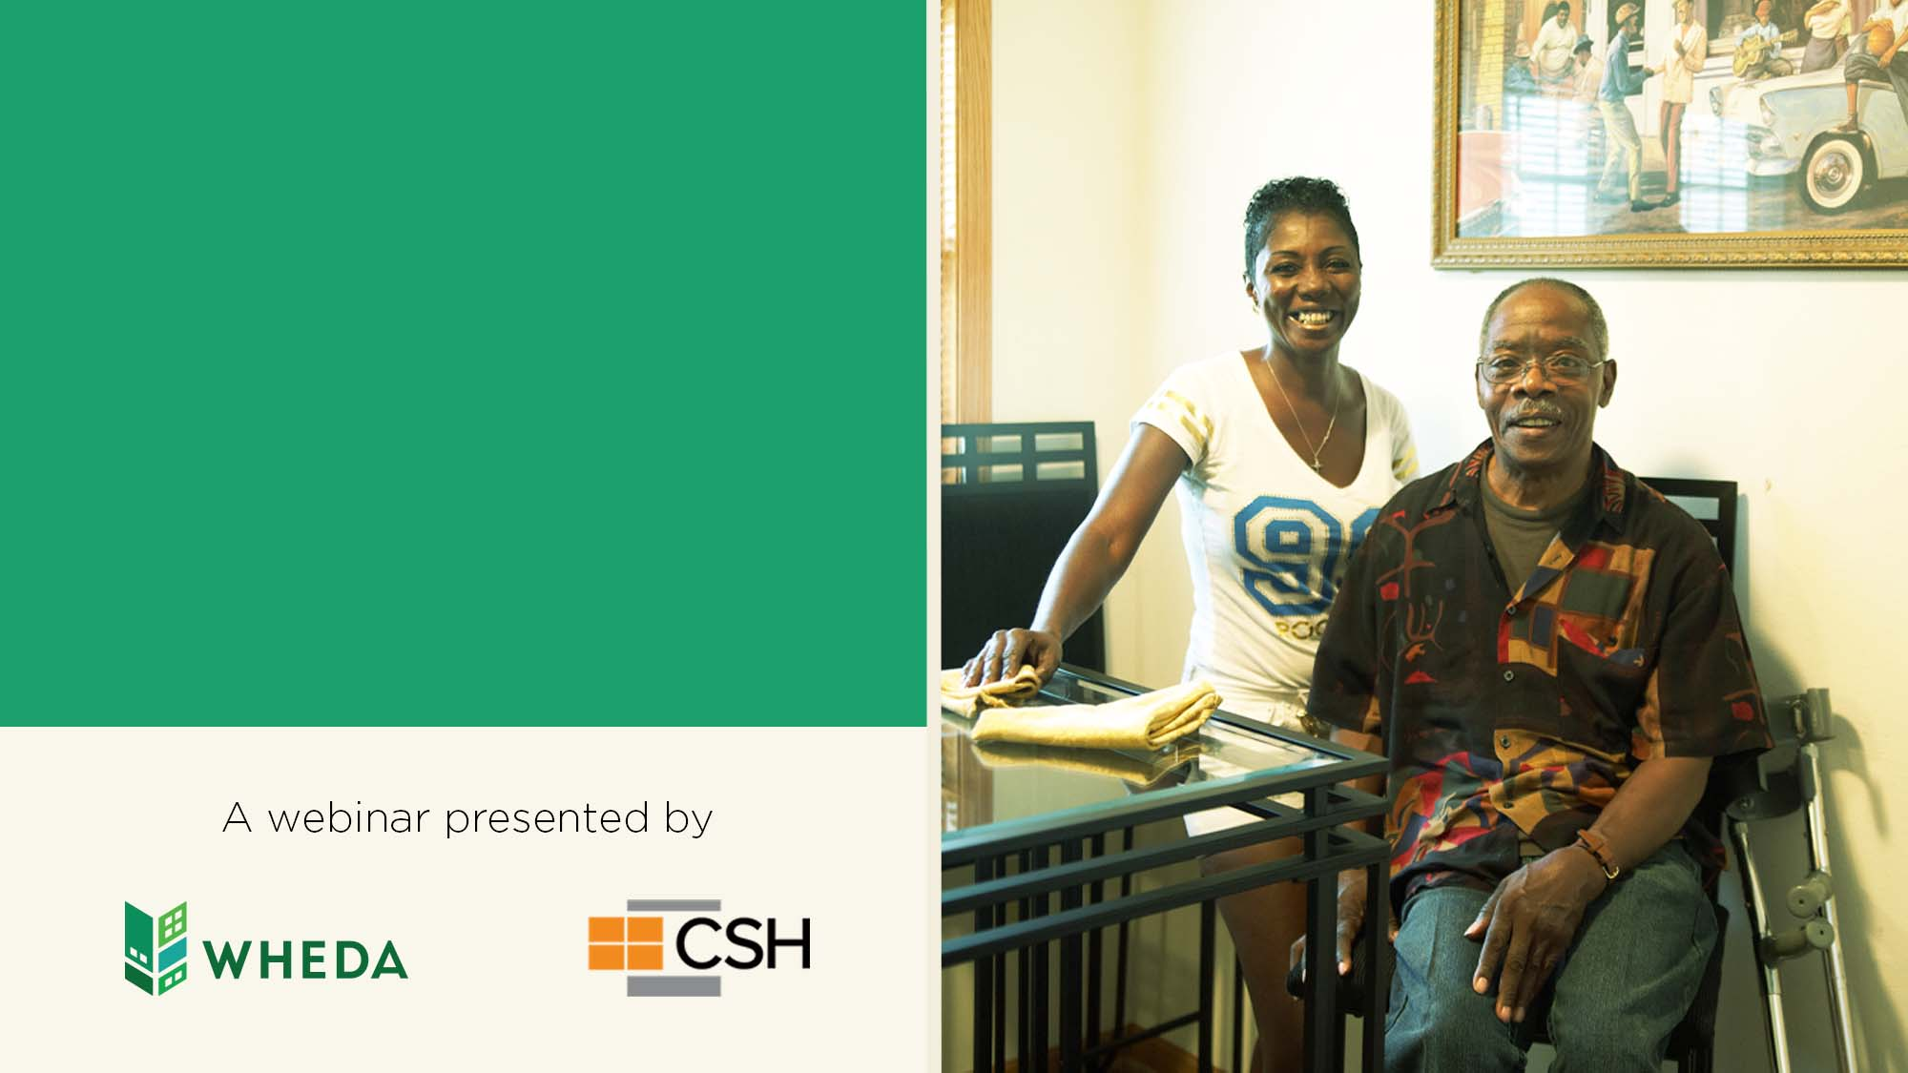
Wisconsin Statewide Supportive Housing Institute

Slide 2

HOW WHEDA WORKS
Our mission:
To stimulate the state’s economy and improve the quality of life for Wisconsin residents by providing affordable housing and business financing products.
Our work:
WHEDA offers financing and expertise to expand equitable access to affordable housing and economic opportunity.

Slide 3
WHEDA SUPPORTIVE HOUSING INITIATIVE
WHEDA partnered with CSH – a national leader in supportive housing.
WHEDA and CSH provided a four-part webinar series to train housing professionals on the basics of supportive housing.
Conducted a statewide survey to better understand the areas of greatest need for supportive housing.
Using the survey results, a first-of-its-kind Wisconsin Supportive Housing Institute is now available.

Slide 4
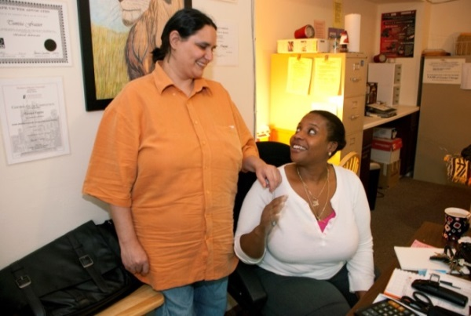


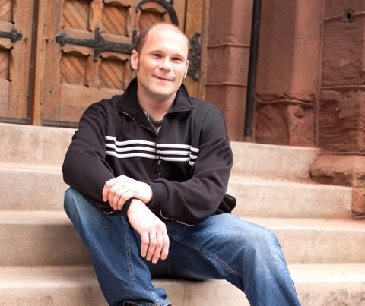


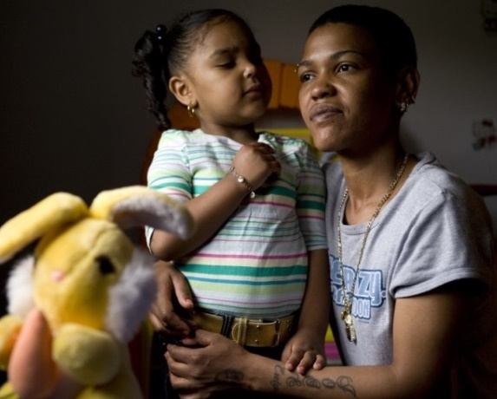


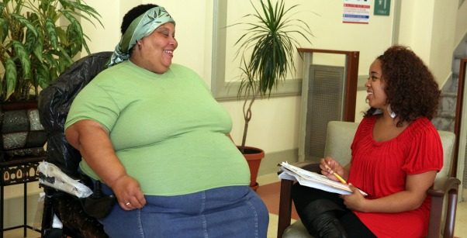

IMPROVING LIVES
Notes:
AMY

Slide 5
Notes:
AMY

Slide 6

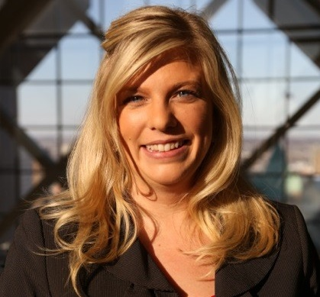
Presenters
Katrina Van Valkenburgh
Managing Director, Central Region
CSH
Amy Stetzel
Upper Midwest Director
CSH
Notes:
AMY AND JOHNNA

Slide 7
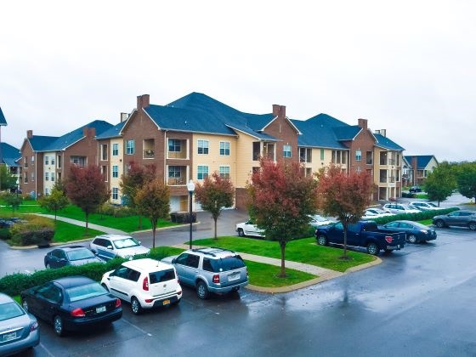
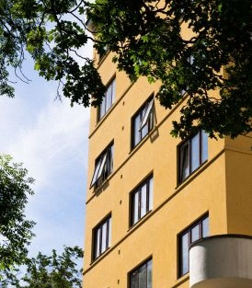
What is Supportive Housing?
Supportive housing combines affordable housing with services that help people who face the most complex challenges to live with stability, autonomy and dignity.
Notes:
So, what is supportive housing?
Supportive housing is affordable housing where supportive service providers actively engage tenants in flexible, voluntary and comprehensive services and work with property and housing management to support tenant stability and ensure that the housing remains a positive community asset for the long-term.
Please visit the WHEDA website to learn more about Supportive Housing and watch the 4-part webinar series WHEDA and CSH did on Supportive

Slide 8
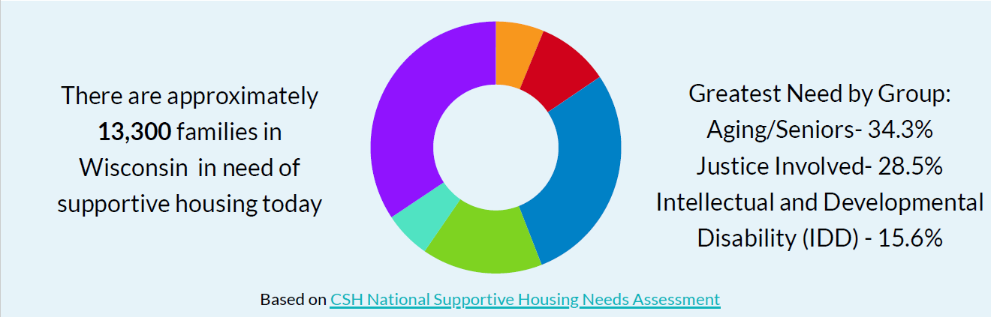
Supportive Housing Need in Wisconsin
Notes:
Facilitator: We start our approach to developing tenant-centered supportive housing by looking at our communities and who we expect to serve in our programs. The data we evaluate will help us understand what services are needed, where to locate programs and they type of model to develop. Lets take a look at the big picture for the state of Wisconsin.
Using the CSH National Supportive Housing Needs Assessment, we find that 13,300 WI household needs supportive housing today with the top 3 biggest needs coming from the Aging, Justice and IDD populations. Aging (4,725 households), Justice (3,922 households) and IDD (2,143 households)

Slide 9
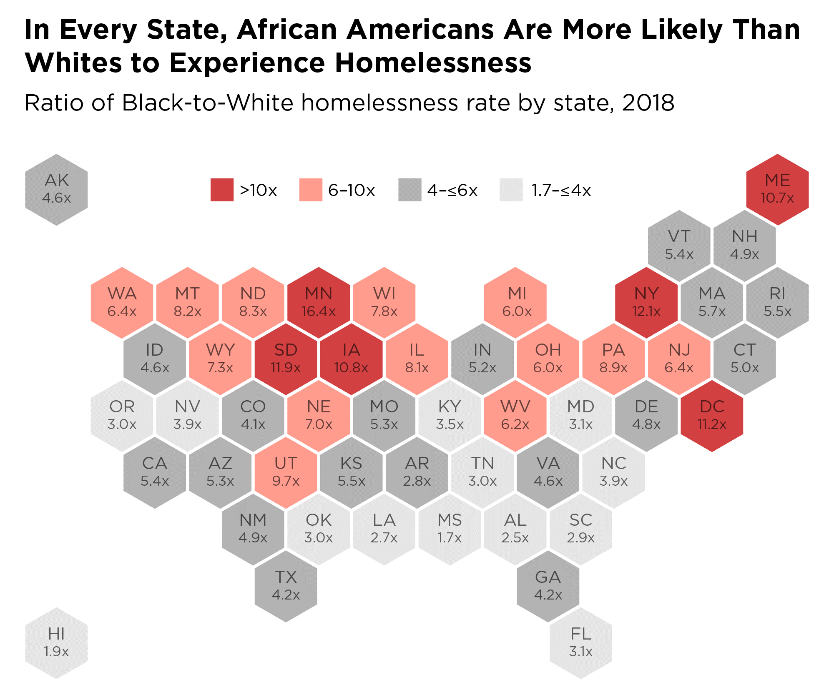
NATIONAL DATA - HOMELESSNESS
US Pop/Homeless
1.35 --> 3% Native
13% --> 40% Black
16.7% --> 22% Latinx
76% --> 49% White
Source: National Alliance to End Homelessness
Notes:
AMY
Facilitator:
Note: This graphic provides further detail, to that demonstrated on the RDDI chart. Point out the data specific to the SHI state’s data.

Slide 10
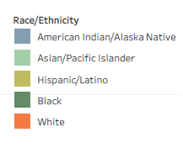
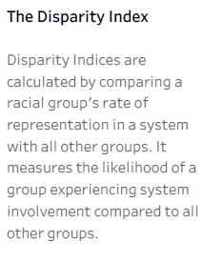
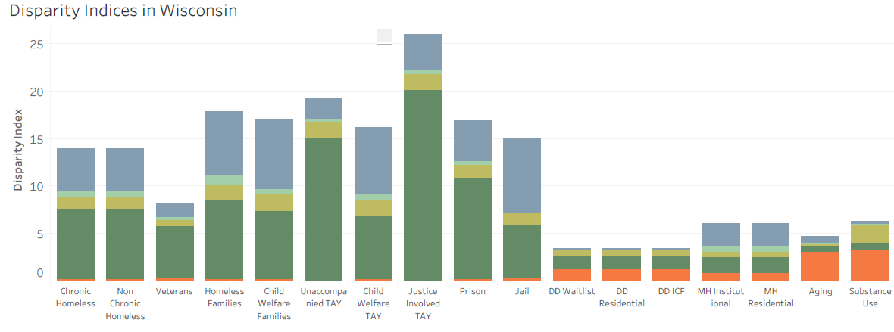
Notes:
AMY
Looking at CSH’s Racial Disparities and Disproportionality Index, the Index that looks at 16 unique systems and measures whether a racial and/or ethnic group’s representation in a particular public system is proportionate to, over or below their representation in the overall population (proportionality) and also allows for the examination of systematic differences between groups and geographies (disparities).
CSH’s Index can be viewed as the “likelihood of one group experiencing an event, compared to the likelihood of another group experiencing that same event.”
What the data tells us is that persons of color disproportionately experience chronic homelessness compared to other groups
African Americans/Black (dark green) very disproportionately represented across many sectors. However, Whites are disproportionately represented in the Aging and Substance Use sectors.
Chronic Homelessness: AA 7.33 times more likely, NA 4.52 times (mirrored exactly in non-chronic homeless numbers – CHECK THIS WITH GABE)
Homeless Families: AA 8.42 times more likely, NA 6.58 times
Unaccompanied Transition Aged Youth: AA 14.99 times more likely
Justice Involved Transition Aged Youth: AA 20.12 times more likely
Prison: AA 10.69 times more likely, NA 4.20 times more likely
Jail: AA 5.67 times more likely, NA 7.71 times more likely
** Substance Use: Whites are 3.29 times more likely to be involved with this sector despite the #s we see in the jail or prison populations.
** Also, the disproportionalities we see in chronic homelessness (and general homelessness), does not match what we see in who is showing up in MH Institutions or MH Residential settings.

Slide 11
What Is the Wisconsin Statewide Supportive Housing Institute?
Capacity Building and Increasing Supply
Notes:
the Supportive Housing Institute is CSH’s premiere workshop experience and it offers 10 days of training and TA delivered over 5 months on the steps needed to develop a supportive housing project for your target population and community.

Slide 12
Housing Developer
Project Manager
Supportive Services Provider
Selected teams will leave the Institute with a detailed development and management plan for their housing project
Notes:
Teams made up of a housing development partner, a supportive service provider and a property manager apply to participate in the Wisconsin Statewide Supportive Housing Institute. 4-7 teams will be selected to participate in the Institute.
.
Teams leave the Institute with a detailed development and management plan for the project, designed to position each team to successfully apply for funding.
The Institute can significantly reduce the time it takes to fund a project by helping build a strong development team equipped to navigate the complex process of developing housing with support services. The Institute is a great way to jump start high-quality supportive housing projects across Wisconsin.

Slide 13
Eligible Applicants
Developing Supportive Housing in Wisconsin
Teams must include a Developer Partner, Property Management Partner and Supportive Service Partner
Developing Supportive Housing for individuals and/or families who are chronically homeless, including youth ages 18-24 and veterans
Teams may include partners who are new to supportive housing as well as more experienced partners

Slide 14
Eligible Supportive Housing Projects
100% Supportive Housing and Integrated Supportive Housing where a minimum of 15%-25% of the units are Supportive Housing
Supportive Housing is permanent and affordable
Tenants hold leases and acceptance of services is not a condition of tenancy
Use of Housing First model which includes eviction prevention and harm reduction strategies
Comprehensive services are accessible to tenants where they live and designed to maximize tenant stability and self-sufficiency
Targets units to individuals, youth, and/or families who meet the HUD definition of Chronic Homelessness
Tenant screening screens tenants into to housing
Supportive Housing must use Coordinated Entry as its referral source and report through HMIS

Slide 15
Virtual Training Format
Sessions will be held from 9am – 1:30pm CT each day
Institute Sessions Will be Delivered Virtually via Zoom platform
Each Session Will Include a Mix of Presentations and Discussions in Large and Small Groups
All Team Members Must Commit to Attending All Training Sessions
The Institute Kicks Off with Sessions on Wednesday February 23rd, Thursday February 24^{th,} and Friday February 25th.
The Institute Culminates in in-person Project Presentations to Funders and Guests at the Finale on June 23rd
CSH Staff Will Lead the Trainings and Will Offer Technical Assistance to Keep Your Project Moving Toward Application for Funding
An in-person site visit will be held in Milwaukee on March 21st

Slide 16
Session 1: February 23rd
  Introduction to Supportive Housing and the Institute
Session 2: February 24th
  Project Concept
Session 3: February 25th
  Roles and Partnerships
Session 4: March 16th
  Project Design
Session 5: March 17th
  Services Planning:
In-person Milwaukee site-visit and meeting: March 21st
Session 6: April 13th
  Supportive Housing Budgets
Session 7: April 14th
  Services and Operating Budgets
Session 8: April 15th
  Capital Budgets
Session 9: May 18th
  Property Management
Session 10: May 19th
  Fair Housing and Quality
Session 11: May 20th
  The First Year
In-person in Madison
  June 22nd: Meeting with Teams, Final Prep and Celebration Dinner
  June 23rd: Institute Finale

Slide 17
Highlights from the Request for Applications: Dates
Link to the RFA is in the chat
Timeline
Applications due Friday January 14, 2022.; No extensions granted.
Applicants will be notified whether they’ve been accepted to participate in the Wisconsin Statewide Supportive Housing Institute by Friday February 11th, 2022
The Institute will begin on Wednesday February 23rd, 2022

Slide 18
Highlights from the Request for Applications: Teams
Team Commitments
  Team may have up to 5 members
  Team must Identify a Team Leader
  Teams are encouraged to incorporate feedback from people with lived expertise into their project
  ALL team members must attend ALL sessions and the site-visit: 13 training days and 1 site visit over 5 months

Slide 19
The Institute RFA and Application
RFA was released on Friday November 19th, 2021
Application is due on Friday January 14th, 2022
Submit Applications to: wisconsin.institute@csh.org
Selection process is competitive and consideration will be given to the following factors:
  Commitment to developing supportive housing project and participating in the Institute
  Capacity and experience of the team members, including financial stability
  Geographic location, to support development across Wisconsin
  Quality of the Response to the Application narrative questions
  Alignment with mission and goals of the Institute
Notes:
Link to the Application is in the chat

Slide 20
Application Questions
Team Member information
Project Concept
Application Narrative
Project Concept
Past Experience and Partnerships
Collaborative Experience
Disproportionate Impact/Racial Equity
Attachments
Application
Audited Financials and Year to Date Current Financials
Letters of Commitment from ED/CEO of Every Team Member’s Organization
Commitment to develop supportive housing that meets the requirements listed in the application
Notes:
Letters of commitment from the Executive Director or CEO of each organization/company attending the Institute. The letter should address the following items:
* Commitment to developing a supportive housing project through the initiative and fulfilling the primary role for which the organization is responsible;
* Capacity to dedicate time to the Institute; it is understood that some organizations may participate that are new to developing supportive housing and we want to ensure that appropriate staff time and capacity is dedicated to this initiative;
* Commitment to communicate with the board or executive leadership throughout the process to ensure board and executive leadership support;
* Commitment for senior level staff and other staff as needed to participate in Institute sessions as described in the RFP; and,
Commitment to develop supportive housing that meets the requirements listed below:
Housing is permanent and affordable
Tenants hold leases and acceptance of services is not a condition of occupancy
Housing is based on the housing first model which includes eviction prevention and harm reduction strategies
Comprehensive case management services are accessible by tenants where they live and in a manner designed to maximize tenant stability and self-sufficiency
The supportive housing development must design tenant screening in a manner that ensures tenants are not screened out for having too little or no income, active or a history of substance use, a criminal record (with exceptions for program mandated restrictions), or a history of victimization; e.g., domestic violence, sexual assault or abuse
The development will use the Continuum of Care’s (CoC) Coordinated Entry system for referrals to the Supportive Housing units and must report through the CoC’s Homeless Management Information System (HMIS)

Slide 21
Accepted Teams
Will need to submit a letter from a Board Chair or Member of Board Executive Committee of not-for-profit project partners affirming commitment to participate in the Wisconsin Statewide Supportive Housing Institute and adhere to the guidelines provided through the RFA.
Due by February 21, 2022

Slide 22


Slide 23
THANK YOU
Questions regarding the Supportive Housing Institute application contact: wisconsin.institute@csh.org
Information regarding WHEDA’s Supportive Housing Initiative:
https://www.wheda.com/developers-and-property-managers/supportive-housing

