Slide 1



ARE YOU READY TO TAKE THE NEXT STEP?
Your First Home
A seminar for first-time homebuyers
Presented By
Markita Jefferson
WHEDA
June 2020)
Wisconsin Housing and Economic Development Authority

Slide 2


LEGAL DISCLAIMER
WHEDA FIRST-TIME HOME BUYER EDUCATION
This information is published and/or provided by WHEDA as a courtesy and is meant for instructional purposes only. None of the information provided is intended to be legal advice in any context. WHEDA makes every effort to provide accurate information. WHEDA does not guarantee, warrant, ensure or promise that it is correct; and any effort to blame WHEDA if this information proves to be incorrect will be vigorously defended. Any unauthorized use, dissemination or distribution of these documents or ideas is strictly prohibited.
Please visit our website at www.WHEDA.com to view full program guidelines. The information contained in this training may not highlight all requirements of these programs and does not reduce or eliminate any requirements set forth in our guidelines. Guidelines are subject to change without notice.
WHEDA is an Equal Housing Opportunity Lender. This is not a commitment to lend. Information is intended for mortgage professionals only and not intended for public use or distribution. Terms and conditions of programs are subject to change at any time. Refer to WHEDA’s underwriting and program guidelines for loan specific details and all eligibility requirements.
©2019 WHEDA All rights reserved

Slide 3

Getting to know WHEDA
WHEDA stands for Wisconsin Housing and Economic Development Authority.
We’re a mission-driven organization established to help renters become homeowners through our unique, affordable financing options.
WHEDA mortgage programs are tailored to individual needs, so home buyers can purchase homes sooner with a mortgage they can afford.

Slide 4
Understanding your loan options starts with learning important Mortgage terms
There are terms people in the mortgage industry will use when working with you. Below are important ones you should know and understand:
Term | Definition
Loan to Value (LTV) | Percentage of mortgage in relation to home value. Example: Value $100,000 Mortgage - $97,000= 97% LTV
Combined Loan to Value (CLTV) | Percentage of total mortgages in relation to home value Example: Value $100,000 -First Mortgage $97,000 -Second Mortgage $3,000 = 97% LTV/100% CLTV
High Combined Loan To Value (HCLTV ) | Percentage of total mortgages in relation to home value Example: Value $100,000 -First Mortgage $97,000 -Second Mortgage $3,000 = 97% LTV/100% CLTV, additional second mortgage or grant $5,000 = 105% HCLTV
Mortgage Insurance Lenders take a risk when loaning money to you to buy a home, and if your LOAN TO VALUE (LTV) exceeds 80% - a type of mortgage insurance will be required. | WHEDA ADVANTAGE FHA FHA requires two types of mortgage insurance Up Front Mortgage Insurance Premium (UFMIP) Currently 1.75% of your first mortgage loan amount It can be paid at closing or financed into your loan Mortgage Insurance Premium (MIP) Calculated at .80% or 85% of your total loan amount divided by twelve Paid monthly over the life of your loan.
 | WHEDA ADVANTAGE CONVENTIONAL There are several different types of mortgage insurance for Conventional loans: Monthly, Single premium, Lender paid The amount of your mortgage insurance depends on your credit score, LTV and loan term
DTI | Debt to Income Ratio – the percentage of your monthly income that your current debts and your mortgage payment will take up

Slide 5
Typical WHEDA Borrower Characteristics
WHEDA FIRST-TIME HOME BUYER EDUCATION
State of Wisconsin average sales price $207,500 (March 2020)
WHEDA average sales price is $141,111 (previous 12 months)
WHEDA LOAN CHARACTERISTICS
Average loan amount is $129,856
81% have LTV > 95%
87% have CLTV > 95%
12% have HCLTV > 100%
69% have Seller Contributions
WHEDA BORROWER CHARACTERISTICS
65% combined income < $65,000
80% under 41
97% First Time Home Buyers
71% Household size 1-2
32% Credit Score < 700
77% utilize WHEDA DPA options
Qualified borrowers do not have to be a first-time homebuyer to be eligible for a WHEDA loan.

Slide 6

Owning a home has many benefits vs. renting.

Slide 7
Owning vs. Renting
Predictable Monthly Payments and owning can be cheaper!
As a homeowner, you can have a predictable mortgage payment for 30 years and in Wisconsin, many times it can be less expensive to own!
Appreciation
Owning a house provides you with a valuable asset that, in many cases will appreciate in value over time, providing you with a great investment for retirement.
Freedom to make modifications..
Renters can not alter the space they are renting without permission from a landlord. Homeowners, on the other hand, don’t need permission.
Your rainy-day fund…
Homeownership provides you with the opportunity to borrow money on the equity you eventually build up by consistently paying your mortgage.
Community Ties
Owning a home allows you to have an impact on your community. The taxes you pay benefit local schools, businesses and organizations.
It’s Yours!
You’ll always have roof over your head!

Slide 8
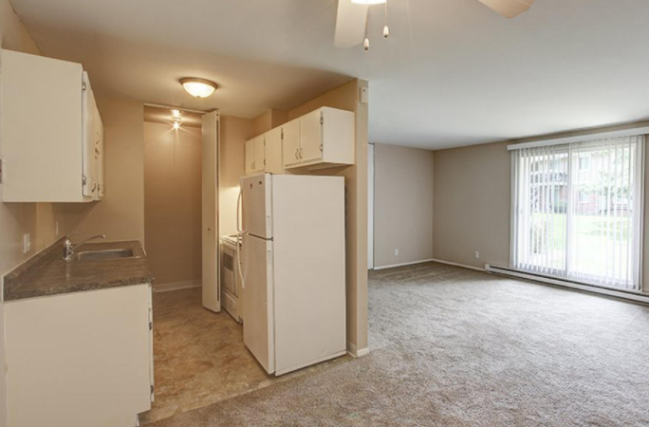
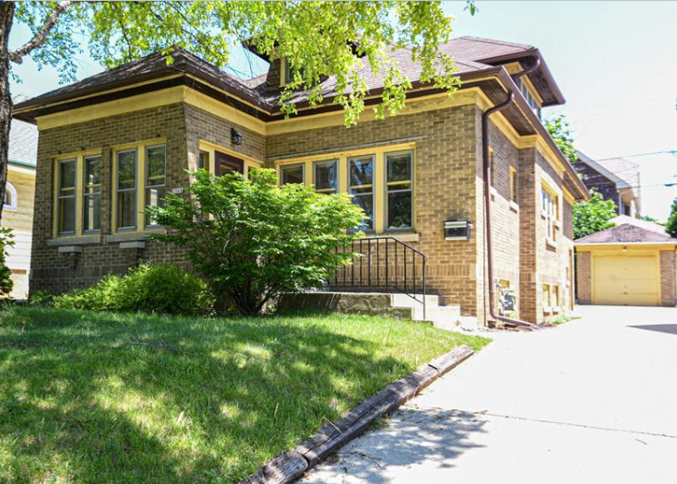
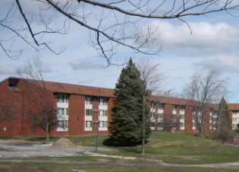
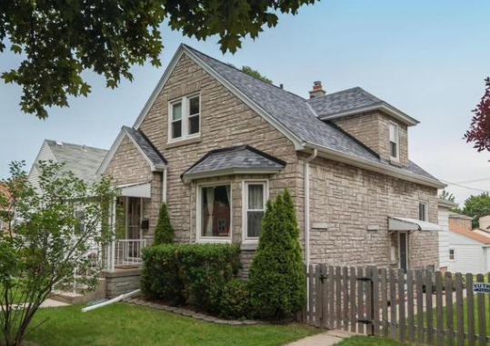
Owning vs. Renting MILWAUKEE
OWN
RENT
Bdrms: 3
Bath: 2
Sq. Ft: 1,388
Monthly Mortgage: $1030.45
Bdrms: 3
Bath: 2
Sq. Ft: 1359
Monthly Rent:
$1,340
Purchase price Interest Rate | $120,000 3.5% | Monthly Amount
1st Mortgage | $116,400 | $523
DPA/2nd | $3,600 | $36
Taxes | $3,468 | $289
Homeowners Ins. | $1200 | $100
Mortgage Ins. | $989.40 | $82.45
Total Payment |  | $1,030.45
DISCLAIMER: THESE ARE MEANT TO BE EXAMPLES AND MAY NOT BE TOTALLY REFLECTIVE OF PAYMENT, BASED ON BORROWER QUALIFICATIONS
Notes:
Milwaukee

Slide 9
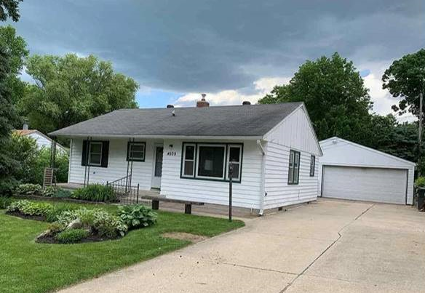
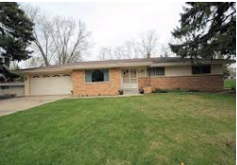
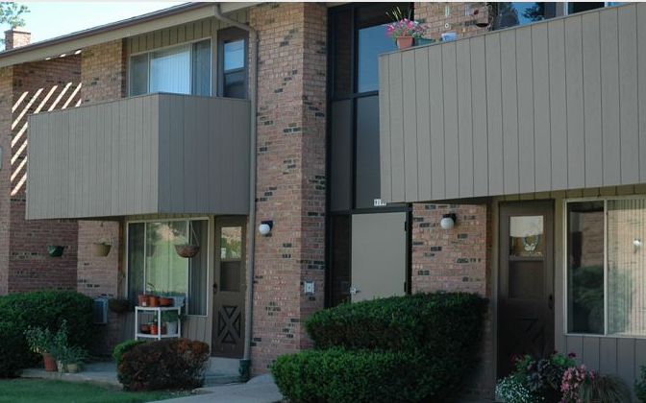
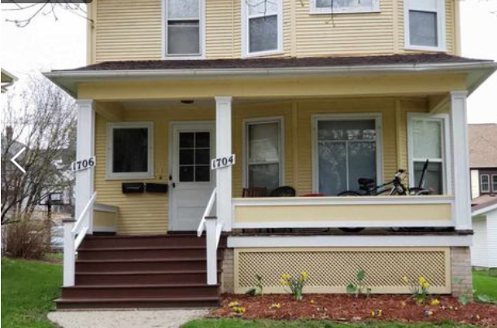
Owning vs. Renting MADISON
OWN
RENT
Bdrms: 3
Bath: 2
Sq. Ft: 1,330
Monthly Mortgage: $1,691
Bdrms: 3
Bath: 1.5
Sq. Ft: 1,110
Monthly Rent: $1,800
Purchase price Interest Rate | $229,900 3.5% | Monthly Amount
1st Mortgage | $223,003 | $1001
DPA/2nd | $6,897 | $68
Taxes | $4,068 | $339
Homeowners Ins. | $1,500 | $125
Mortgage Ins. | $1895.53 | $157.96
Total Payment |  | $1,690.96
DISCLAIMER: THESE ARE MEANT TO BE EXAMPLES AND MAY NOT BE TOTALLY REFLECTIVE OF PAYMENT, BASED ON BORROWER QUALIFICATIONS
Notes:
Madison

Slide 10
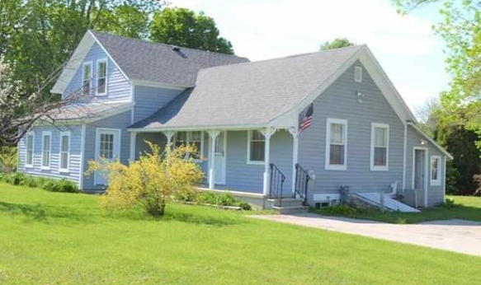
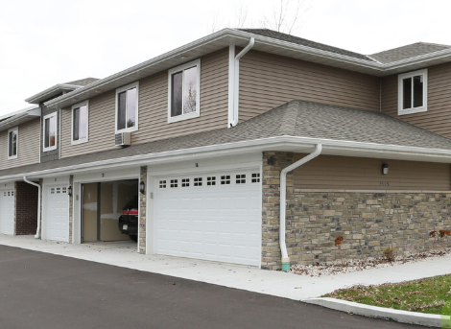
Owning vs. Renting GREEN BAY
OWN
RENT
Bdrms: 3
Bath: 2
Sq. Ft: 1,325
Monthly Mortgage: $950
Bdrms: 3
Bath: 2
Sq. Ft: 1,485
Monthly Rent: $1,345
Purchase price Interest Rate | $124,000 3.5% | Monthly Amount
1st Mortgage | $120,280 | $540
DPA/2nd | $3720 | $37
Taxes | $2,256 | $188
Homeowners Ins. | $1,200 | $100
Mortgage Ins. | $1022.38 | $85.20
Total Payment |  | $950.20
DISCLAIMER: THESE ARE MEANT TO BE EXAMPLES AND MAY NOT BE TOTALLY REFLECTIVE OF PAYMENT, BASED ON BORROWER QUALIFICATIONS
Notes:
Green Bay

Slide 11

Reasons you may be nervous about home ownership…
Credit Concerns
Your mortgage loan officer will let you know what you qualify for. You can request a free copy of your credit report at annualcreditreport.com.
Lack of Knowledge
You’ll learn a lot of the basics today! Plus, your mortgage loan officer will help with anything you may not know or understand.
Picking The Wrong House
Knowing your “wants” and “needs” will eliminate the anxiety of choosing the wrong home.
Affordability
Getting pre-approved assures you that you’re capable of paying the note
You Never Thought You Could afford to own a home
You can!
And you’ll learn how today!

Slide 12
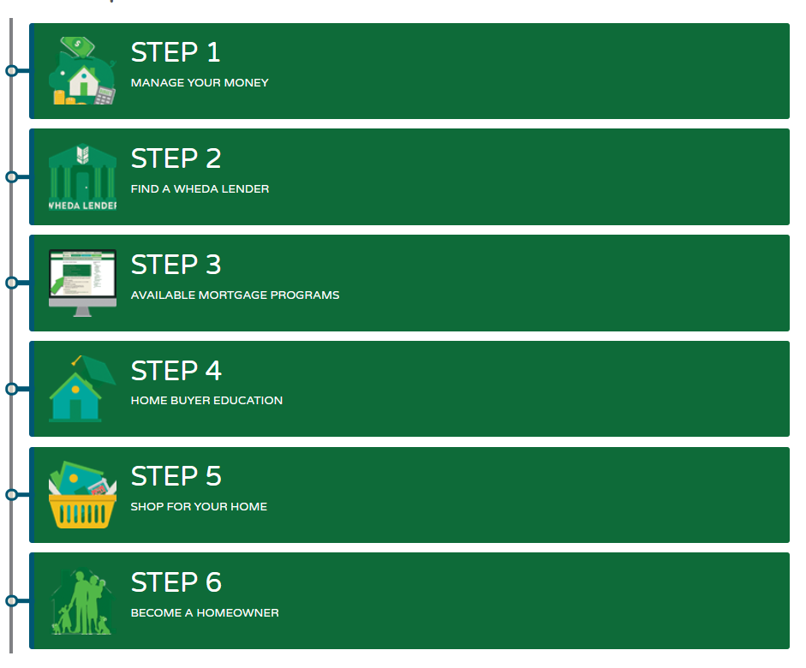
AGENDA
WHEDA FIRST-TIME HOME BUYER EDUCATION

Slide 13


WHEDA FIRST-TIME HOME BUYER EDUCATION
STEP 1: Manage Your Money
Buying a home is one of the biggest, most exciting decisions you’ll ever make. Let WHEDA guide you toward your future home.
How you have paid your debts is an important indicator to lenders of how you will repay your loan. If you have credit problems, or feel you need help managing your budget to prepare for home ownership, you may want to contact a credit counseling agency.
These agencies are primarily community-based nonprofit groups that specialize in pre- and post-purchase homeowner education and credit counseling.

Slide 14

KNOW YOUR CREDIT SCORE
Your credit score affects your down payment
Once you’ve made the decision to buy a home, it’s a good idea to review your
credit standing.
The type of loan you get, including interest rate and points paid, is primarily determined by your credit score.
The better your credit score, the more affordable loan you can get, often with more options for a low-down payment.
WHEDA’s minimum credit score requirement is
620 for Conventional loans
640 for FHA loans.

Slide 15
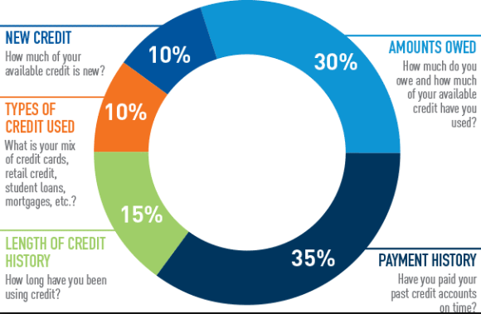
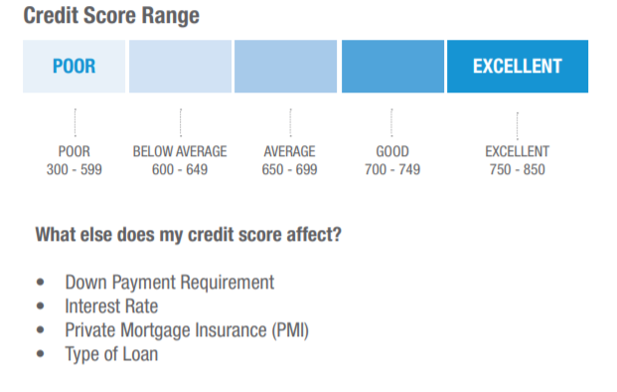
Your credit score, also known as FICO score, is determined be several things
SOURCE: Credit Secrets Club

Slide 16
Credit troubles and Credit Solutions
Avoid paths to credit troubles:
Late payments affect your credit history.
  Anything paid over 30 days from the due date will be reflected as a late payment that will last the history of your credit.
Making only the minimum payment.
  Making the minimum payment is better than not paying at all, however it will cost you a lot of money in interest charges and keep your debt level high.
Constantly opening new credit
  Each time a new credit card or loan is opened, it will lower your score due to increasing your debt.
Establishing a good credit history is simple:
Open a checking or savings account.
  Maintain your checking account by keeping enough money in it to cover all outstanding checks. Make regular deposits in your savings account to establish a history of savings.
Apply for credit gradually.
  Apply for it once your checking and savings accounts are in good standing and you believe your budget can handle the potential for debt.
Make regular on time payments
  On any debt you have – credit cards, loans and even cell phones. Every time you make a payment as agreed, you are building a positive credit history. If you consistently repay your debts on time, a good credit history will improve your credit score.
Webinar attachment #1 includes links to all 3 credit repositories, as well as annualcreditreport.com.
Review your credit report and get prepared, so you can enjoy the lowest interest rate possible
and save cash over the life of your loan.

Slide 17
CREATE A BUDGET
What a budget is, and how to establish a good one
Make goals specific
Be prepared to compromise
Set realistic goals and objectives
Exercise will power
Be flexible
Develop a good record keeping system
A budget is a plan that lays out your income and expenses as precisely as possible.
To establish a good budget
Start with identifying your expenses
Keep a detailed record of all income and expenses
This record should include all of your expenses, right down to your morning latte.
The “Monthly Budget Worksheet ” (webinar attachment #2) is a simple tool to help you put your budget on paper.
Helpful
Tips

Slide 18
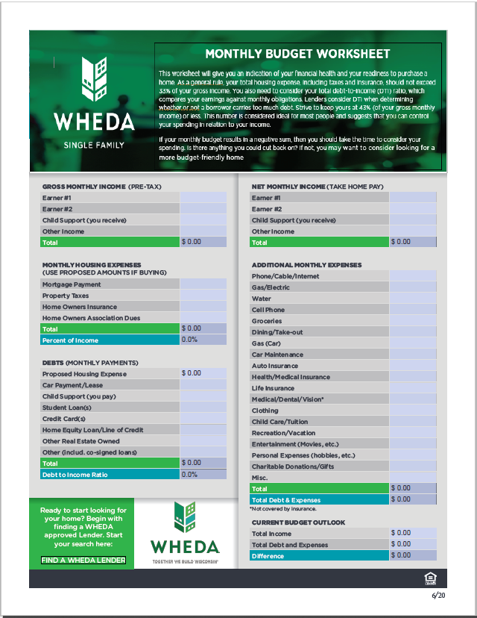
WHEDA FIRST-TIME HOME BUYER EDUCATION
WHEDA’S MONTHLY BUDGET WORKSHEET
BUDGET FOR HOME OWNERSHIP

Slide 19

WHEDA FIRST-TIME HOME BUYER EDUCATION
STEP 2: Find a WHEDA Lender
Our mortgage lender partners look at:
1. Your monthly income
2. Credit history
3. Debt level
to qualify you for a WHEDA loan that best fits your needs.
WHEDA offers two different options for first mortgages:
A Conventional First Mortgage
First-Time Home Buyers (FTHB), Eligible veterans (VALOR), OR Target area purchaser receive reduced pricing if they are qualified
A Federal Housing Administrated (FHA) Mortgage
FIND A WHEDA APPROVED LENDER
Feel free to visit several lenders before deciding
You can find WHEDA’s statewide network of lenders by going to the Find a WHEDA Lender link:
Specific county
Specific city in Wisconsin
You can search for a lender/bank by
Once your search results are displayed, you can filter your results alphabetically, by county, or by city
Name

Slide 20
WHEDA FIRST-TIME HOME BUYER EDUCATION
5 Questions for Prospective Lenders
1. What is your process for preapproval and closing?
Your minimum down payment will depend on the type of loan your lender recommends for you.
4. Do you offer grant assistance like Down Payment Plus?
State and local housing agencies administer a wide range of programs, including grants.
5. What fees will be included in my loan and due at closing?
Lender fees will be associated no matter what loan product you choose.
Make sure the lender’s timelines line up with your home buying goals.
3. What will be my down payment requirement?
2. How do you communicate with homebuyers?
Ask how they will manage your loan process and all the steps along the way.
What information will your lender need to preapprove you for a home loan?
Think about how you like to communicate and what works for your schedule.
The good news is that 20 percent down is not required today. Several loans today offer a 3 – 5 percent down payment.
Some lenders offer they own proprietary down payment help as well.
They may include origination fees, underwriting or processing fees, etc
Standard fees may include appraisal fee, title fee, loan closing fee, credit report fee and Tax service fees
Knowing what your fees are is just as important as your interest rate.

Slide 21
WHEDA FIRST-TIME HOME BUYER EDUCATION
WHAT TO BRING TO YOUR FIRST MEETING WITH YOUR LENDER
Residential history
Your residential address for the past two years
Landlord names and addresses for the past two years
Personal assets
Bank account statements from the most recent months for all checking and savings accounts
Other asset statements from the past two months for any CDs, IRAs, stocks, bonds or other securities you intend to use for your down payment
Current real estate holdings, including property address, current market value, mortgage lender's name and address, loan account number, balance and monthly payment
Employment & income history
Paycheck stubs from the last 30 days showing your year-to-date earnings
W-2 forms (issued by your employer) for the past two years
Most recent Federal tax returns with all schedules
Personal debt
A list of any new monthly debts not listed on your credit report (auto loans, student loans, mortgage loans, credit cards, etc.), including creditor name, address, account number, minimum monthly payment amount and outstanding balance on each account
Identification
Copy of personal identification to very your identity
Social Security card
This will help your Lender determine the best first mortgage loan and down payment assistance option for you!

Slide 22

WHEDA FIRST-TIME HOME BUYER EDUCATION
What will my lender do at our initial meeting?
Not all lenders have the same business model, therefore there are no EXACT procedures. Some of the things that usually take place are:
Determining what price range home you are looking for and what down payment you want to make, if any.
Reviewing the documentation you have provided.
Calculating your income, pull an initial credit report.
Determining if you may qualify for a mortgage and discussing your different loan options based on your down payment, Income, credit and property type.
If your Lender determines you do qualify for a mortgage, you may be issued:
Prequalification
Preapproval
If necessary, providing further documentation or explanations for poor credit, gaps in employment, etc.
Whether you need to work on repairing your credit or establishing a longer employment history before being able to qualify.
generally this is NOT a firm commitment as it simply indicates based on what they have, you appear to qualify for a mortgage in a specific amount. It may list certain conditions that will have to be met or additional documentation that will need to be provided and reviewed
is a credit approval or decision, based on a complete review of your income, assets, credit report.

Slide 23
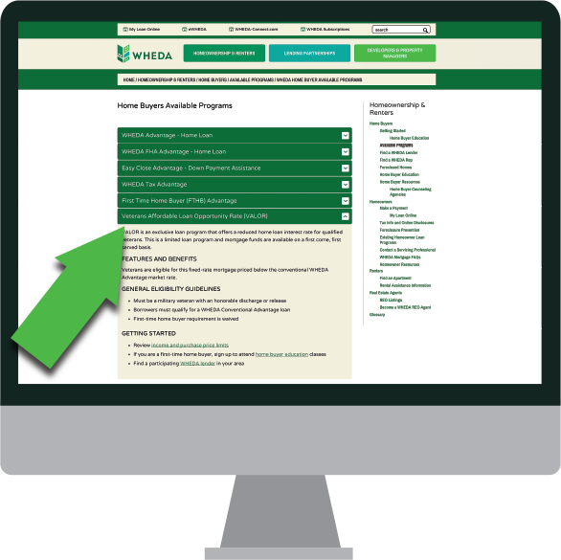

WHEDA FIRST-TIME HOME BUYER EDUCATION
STEP 3: Available Mortgage Programs
UNDERSTAND YOUR LOAN OPTIONS
WHEDA has mortgage programs tailored to your individual needs, whether you are purchasing or refinancing, and a first-time or a repeat buyer.
We have two first mortgage program options:
  WHEDA ADVANTAGE CONVENTIONAL LOAN PROGRAM
  WHEDA ADVANTAGE FHA LOAN PROGRAM
Both programs have different features and benefits along with different guidelines

Slide 24
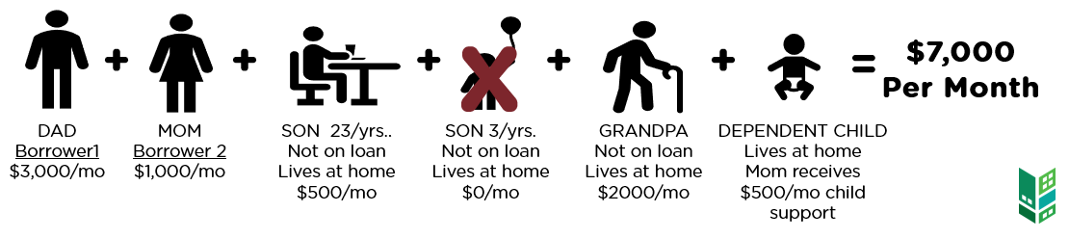
WHEDA’s First Mortgage Loan programs Total Household Compliance Income:
ALL WHEDA FIRST AND DPA PROGRAMS HAVE TOTAL HOUSEHOLD COMPLIANCE INCOME LIMITS
WHAT IT IS?
Total Household Compliance Income
Anticipated income of ALL BORROWERS and anyone 18 years or older who intends to occupy the property regardless to their relationship to the borrower.
ALL income counts
COMPLIACNCE INCOME IS NOT THE SAME AS QUALIFYING INCOME
WHOSE INCOME COUNTS IN TOTAL HOUSEHOLD COMPLIANCE INCOME?
Income Limits can be found here: https://www.wheda.com/globalassets/documents/mortgage-lending/income-and-purchase-price-limits.pdf

Slide 25
WHEDA’s First Mortgage Loan options provide:
CONVENTIONAL and FHA
Allow up to 105% Financing for qualified borrowers who utilize a WHEDA first mortgage and a WHEDA DPA
FHA
Required Borrower Investment is satisfied with the use of either of WHEDA’s DPA’s
CONVENTIONAL
Have the option to buy and renovate a home by financing all repairs etc. into mortgage.
Offer reduced rates for First Time Home Buyers, Veterans or if purchasing in a "Target area“
Offer reduced mortgage insurance if you qualify
TWO DOWN PAYMENT ASSISTANCE OPTIONS
When used with a WHEDA first mortgage provide 100% financing on all property types except 2-4 unit on a Conventional loan
LOCAL SERVICING OF YOUR WHEDA LOAN

Slide 26
WHEDA ADVANTAGE CONVENTIONAL LOAN
Reduced Pricing Eligibility and Requirements
WHEDA FIRST-TIME HOME BUYER EDUCATION
REDUCED PRICING OPTIONS are available on WHEDA’S CONVENTIONAL PROGRAM FOR:
  First Time Home Buyers (BOTH borrowers must qualify)
  Eligible Veterans (Called VALOR – only ONE Borrower must qualify)
  Target Area Borrowers
Must also be under the Total Household Compliance Income Limits for the reduced pricing option
First Time Home Buyer (FTHB)
No ownership interest in a principle residence or benefit of homeownership within the previous 3 years (as defined by the IRS)
Eligible Veteran
Must provide a DD-214 reflecting honorable discharge
Certificate of Eligibility does not replace a DD-214
( NO FUNDING FEE)
Purchasing in a designated Target Area
https://www.wheda.com/globalassets/documents/mortgage-lending/mcc-tax-advantage/fthb-and-tax-advantage-target-areas.pdf
HOME BUYER EDUCATION REQUIREMENTS ON ALL LOANS
ONE BORROWER IS REQUIRED TO COMPLETE HOME BUYER EDUCATION
LANDLORD EDUCATION REQUIREMENTS ON PURCHASE OF A 2 UNIT OR 2-4 UNIT
ONE BORROWER IS REQUIRED TO COMPLETE

Slide 27
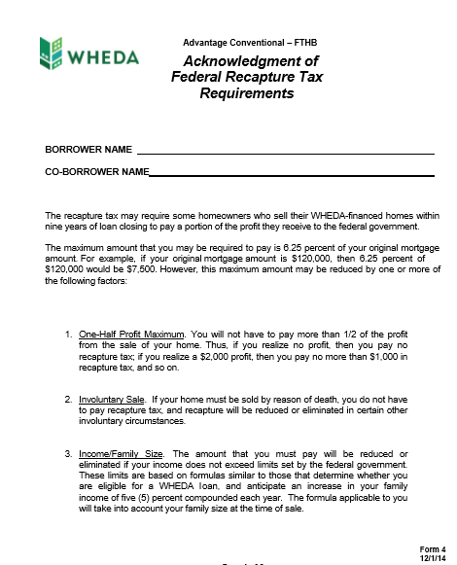
WHEDA ADVANTAGE CONVENTIONAL ONLY
FEDERAL RECAPTURE TAX
WHEDA FIRST-TIME HOME BUYER EDUCATION
VERY IMPORTANT
What is Federal Recapture Tax?
A federal tax a borrower may be required to pay from net profit from the sale of a home that was financed through tax credits
This requirement comes from the federal government.
How is Recapture Tax calculated?
The maximum recapture tax is 6.25% of the original principal balance of the loan or 50% of the gain on the sale of your home whichever is less.
Federal Recapture Tax may apply if ALL the following occur:
Home is sold during the first nine years of ownership; and
Homebuyer has a gain (net profit) on the sale of the home; and
Homebuyers “Adjusted Qualifying Income” exceeds the Income Limits the year of the sale or transfer
WHEDA has three programs that are considered bond programs
Conventional Advantage First Time Home Buyer
Conventional Advantage VALOR
Mortgage Credit Certificate
WHEDA GUARANTY:
If a WHEDA Borrower meets all three Federal Recapture Tax requirements and is subject to paying the tax, WHEDA will fully reimburse the Borrowers 100% of Federal tax liability
Borrowers are provided with a written guaranty at closing:
WHEDA Form 4 Recapture Tax Reimbursement
Resources
For details on “Adjusted Qualifying Income” - https://www.irs.gov/pub/irs-pdf/i8828.pdf
IRS Publication 523 “Selling Your Home,” available on the IRS website at: www.irs.gov.
The toll-free telephone number of the IRS is 800-829-1040.

Slide 28
WHEDA ADVANTAGE CONVENTIONAL LOAN
General eligibility guidelines
WHEDA FIRST-TIME HOME BUYER EDUCATION
 | WHEDA Advantage Conventional
WHEDA Requirements | Property must be located in Wisconsin Must be owner occupied for life of WHEDA loan Do not have to be a first-time home buyer to utilize this program
Credit Score/DTI Ratio | Minimum credit score 620 or higher Debt to Income ratio determined by Lender Automated Underwriting System
Purpose | Purchase or WHEDA to WHEDA Limited Cash Out Refinance
Term/Type | 30 year Fixed
Allowed Property Type | SFR 97% Loan to Value 2/4 Units (over 5 years old) 95% Loan to Value CONDOS-Warrantable – 97% Loan to Value MANUFACTURED HOUSING-Double Wide - 95% Loan to Value
Minimum down payment | $0.00 on Single Family properties, Condominiums and Manufactured Homes with use of WHEDA Easy Close down payment assistance 3% of purchase price and 6 months reserves on 2-4 Unit properties
Total Household Compliance Income | Anticipated income of anyone 18 years or older who intends to occupy the property regardless to their relationship to the borrower Must be under the Income limit for the county the property being purchased is in, the program and the total household occupant size
Secondary Financing | BOTH WHEDA Down Payment Assistant programs allowed for up to 105% CLTV Additional down payment assistance or grants allowed up to 105% Combined Loan to Value if they meet FNMA “Community Seconds” requirements
Counseling Requirements | PRE-PURCHASE HOME BUYER EDUCATION (HBE) IS REQUIRED FOR FIRST TIME HOME BUYERS IF PURCHASING A 2-UNIT, ONE BORROWER MUST COMPLETE LANDLORD EDUCATION

Slide 29
WHEDA ADVANTAGE FHA LOAN
General eligibility guidelines
WHEDA FIRST-TIME HOME BUYER EDUCATION
 | WHEDA Advantage FHA
WHEDA Requirements | Property must be located in Wisconsin Must be owner occupied for life of WHEDA loan Do not have to be a first-time home buyer to utilize this program
Credit Score/Debt To Income Ratio | Minimum credit score 640 or higher Debt to Income ratio MAX of 45%
Purpose | Purchase
Term/Type | 30 year Fixed
Allowed Property Type | SFR - 96.5 Loan To Value /up to 105 % High Combined Loan To Value 2 Units (over 5 years old) - 96.5 Loan To Value /up to 105 % High Combined Loan To Value HRAP Condos - 96.5 Loan To Value /up to 105 % High Combined Loan To Value Condominiums- 96.5 Loan To Value /up to 105 % High Combined Loan To Value
Minimum borrower investment | FHA requires a 3.5% minimum Borrower investment, but BOTH WHEDA Down Payment Assistance options satisfy this requirement
Total Household Compliance Income | Anticipated income of anyone 18 years or older who intends to occupy the property regardless to their relationship to the borrower Must be under the Income limit for the county the property being purchased is in, the program and the total household occupant size
Secondary Financing | BOTH WHEDA Down Payment Assistant programs allowed for up to 105% HCLTV Additional down payment assistance or grants allowed up to 105% High Combined Loan to Value if they meet HUD secondary financing requirements
Counseling Requirements | PRE-PURCHASE HOME BUYER EDUCATION (HBE) IS REQUIRED FOR FIRST TIME HOME BUYERS, BUT IS WAIVED IF ONE BORROWER IS NOT A FIRST TIME HOME BUYER IF PURCHASING A 2-UNIT, ONE BORROWER MUST COMPLETE LANDLORD EDUCATION

Slide 30
Understanding FHA Up Front Mortgage Insurance Premium (UFMIP)*
WHEDA FIRST-TIME HOME BUYER EDUCATION
Borrowers who take out an FHA loan incur a mortgage insurance premium at closing.
This premium is referred to as the, “upfront mortgage insurance premium” or UFMIP.
FHA’s UFMIP is 1.75 percent of the loan size.
It does not affect the loan’s LTV or loan-to-value calculation.
This premium can be paid at closing OR added on to the total amount of the first mortgage loan.
EXAMPLES:
UFMIP FINANCED:
First mortgage loan of $100,000 + UFMIP of $1,750 (1.75% of $100,000) would result in a first mortgage loan of $101,750
UFMIP PAID AT CLOSING :
First mortgage loan of $100,000, UFMIP of $1,750 (1.75% of $100,000) paid at closing, would result in a first mortgage loan of $100,000
*NOTE: UFMIP is subject to change without notice

Slide 31
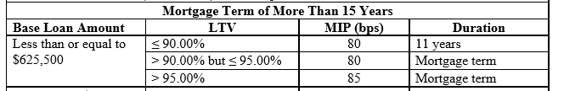
Understanding FHA Monthly Mortgage Insurance Premium (MIP)*
WHEDA FIRST-TIME HOME BUYER EDUCATION
Borrowers who take out an FHA loan must pay a monthly mortgage insurance premium of “MIP”
The monthly insurance premium is a percentage based on the LTV per chart below.
To calculate the MIP, multiply the total loan amount by applicable % and divide the sum by 12.
FHA requires rounding to the nearest cent.
Add this amount to the monthly principal, interest, taxes and hazard insurance payment = total monthly mortgage payment.
NOTE: The majority of WHEDA Advantage FHA loans have Life of Loan MIP and all TRID documents MUST correctly disclose this to avoid costly curative action.
EXAMPLES:
UFMIP FINANCED:
First mortgage loan of $100,000 + UFMIP of $1,750 = first mortgage loan of $101,750
MIP - $101,750 X .85% = $864.88/12 = $72.07 MIP
UFMIP PAID AT CLOSING :
First mortgage loan of $100,000, UFMIP of $1,750 paid at closing = first mortgage loan of $100,000
MIP - $100,000 X .85% = $850.00/12 = $70.83 MIP

Slide 32
The WHEDA monthly mortgage payment is made up of five elements:
Principal
Interest
1/12th of annual Real Estate Taxes
1/12th of annual Homeowners Insurance
Mortgage Insurance (CONVENTIONAL -if LTV exceeds 80%) Monthly Insurance Premium (FHA – Regardless of LTV)
Principal = Money you are repaying to the bank.
Interest = What the bank charges you for the privilege of using its money to buy the home.
Real Estate Taxes = You pay your annual property taxes in 12 equal installments.
Homeowners Insurance = You pay your annual property taxes in 12 equal installments.
CONVENTIONAL LOANS
  Mortgage Insurance = If your Loan-to-Value exceeds 80%, you will be required to pay monthly mortgage insurance based on your LTV/CLTV and Credit Score.
FHA LOANS
  Monthly Mortgage Insurance Premium (MIP) regardless of LTV

Slide 33
WHEDA offers two types of down payment assistance options
Use with a WHEDA first mortgage to get 100% financing**
WHEDA Easy Close | WHEDA Capital Access DPA
CONVENTIONAL Minimum loan amount of $1000 Loan amount is the greater of $3000 or 3% of the purchase price when partnered with a WHEDA Conventional first mortgage loan | CONVENTIONAL Minimum loan amount of $3,050 Loan amount is the greater of $3,050 or 3% of the purchase price when partnered with a WHEDA conventional loan
FHA Minimum Loan amount of $1,000 Loan amount is the greater of $3,500 or 3.5% of the purchase price when partnered with a WHEDA FHA first mortgage loan | FHA Minimum loan amount of $3050 Loan amount is the greater of $3,050 or 3.5% of the purchase price when partnered with a WHEDA FHA loan
10-year fixed rate second mortgage with monthly payment Interest Rate is same as first mortgage* | 30-year fixed rate mortgage 0% Interest rate* NO MONTHLY PAYMENTS!
Total Household Compliance Income limits apply | Has separate Total Household Compliance Income Limits which are generally lower
Can be followed by additional secondary financing as loan as it meets Fannie Mae (Conventional) requirement or HUD (FHA) requirements Max HCLTV of 105% | Can be followed by additional secondary financing as loan as it meets Fannie Mae (Conventional) requirement or HUD (FHA) requirements Max HCLTV of 105%
** Conventional 2-4-unit, max LTV is 95% - DPA will not equal 100% financing
*Actual APR may vary.

Slide 34

WHEDA FIRST-TIME HOME BUYER EDUCATION
STEP 4: Home Buyer Education
Get educated! Learn about the buying process, financing options, and being a responsible homeowner.
First-time borrowers using a WHEDA loan are required to take a home buyer education class
In addition, if purchasing a 2-4-unit property, at least one borrower must also complete an approved landlord education course.
Check with your lender on which type of education you will need.
Both Home Buyer Education and Landlord Education must have been completed prior to purchase and are good for within 12 months of the application date.
There are several in-person and online options.

Slide 35
HOMEBUYER EDUCATION PROVIDERS
WHEDA FIRST-TIME HOME BUYER EDUCATION
Free online providers and In-person counselors
Acceptable WHEDA Approved free online sources of Home Buyer Education:
Arch Mortgage Insurance Company
Essent Guaranty Inc.
Genworth Mortgage Insurance Corporation (Genworth)
Mortgage Guaranty Insurance Corporation (MGIC)
Acceptable WHEDA sources of in person Home Buyer Education and Counseling:
Any costs are set by provider and must be included on Loan Disclosures provided by Lender
eHome America
Framework Homeownership
ACTS Housing
List of statewide approved counseling agencies

Slide 36
LANDLORD COUNSELING PROVIDERS
WHEDA FIRST-TIME HOME BUYER EDUCATION
Free online providers and In-person counselors
Acceptable WHEDA Approved free online sources of Landlord Education:
Essent
Genworth
MGIC
Radian
Acceptable WHEDA sources of Landlord Education.
Any costs are set by provider and must be included on Loan Disclosures provided by Lender
Fannie Mae's Becoming a Landlord:
City of Milwaukee Landlord Training

Slide 37



WHEDA FIRST-TIME HOME BUYER EDUCATION
STEP 5: Shop For Your Home
Get pre-approved! Finding out how much house you can afford narrows your search saving you time. After pre-approval, you can work with a qualified real estate professional to find a home in your target neighborhood and price range.
KEEP IN MIND! Unless you and the real estate agent have entered into a “Buyer’s Agency Agreement”, the Real Estate Agent is representing the Seller.

Slide 38

WHEDA FIRST-TIME HOME BUYER EDUCATION
When shopping for a home, be sure you know exactly what you
NEED
in your home, as opposed to the things you may
WANT
Wants:
Granit countertops
Stainless steel appliances
Marble in foyer
In-ground pool
Lots of land
Hot tub
Walk-in closets
Needs:
3 bedrooms
2 bathrooms
Well-maintained
Garage
Good school district
Close to public transportation
Short distance to work
Use the Homebuyer Checklist (webinar attachment #3) as a guide for you to list all of your needs before you start looking at homes, and to help you keep track of how each property you look at matches up with your list.

Slide 39

WHEDA FIRST-TIME HOME BUYER EDUCATION
HOMESTYLE RENOVATION - You find a house, WHEDA will help you make it a home.
Not every home is move-in ready
Purchase a home & renovate it with a single mortgage
6 Months after closing to complete renovation work
All costs associated with your renovation –
including six months of mortgage payments
if you are unable to occupy your home during
renovation – can be financed, depending on appraised value.
If you’re having a hard time finding a home that meets your needs, consider WHEDA’s…
Conventional Homestyle®
Renovation

Slide 40
WHEDA FIRST-TIME HOME BUYER EDUCATION
ONCE YOU’VE FOUND YOUR HOME…….
Your Real Estate Agent will assist you with writing an OFFER TO PURCHASE
Remember - Unless you and the real estate agent have entered into a “Buyer’s Agency Agreement”, the Real Estate Agent is representing the Seller.
Once your offer is accepted, you will need to get the accepted offer to your Lender
Your Lender will proceed with the following steps:
Documenting any Earnest Deposit you put down – This is like a “security deposit” on your offer
Making sure any inspections are completed – the Sellers will provide a Real Estate Condition Report where they must disclose any “defects”. This may trigger a specific inspection
Provide you with the Loan Estimate based on the parameters of your purchase. It will disclose all fees based on the loan amount.
Order an appraisal to make sure the property is worth what you are paying for it
The Consumer Financial Protection Home Loan Toolkit can provide you with a lot of useful information on Lender disclosure requirements, and much more!

Slide 41
WHEDA FIRST-TIME HOME BUYER EDUCATION
What to expect at closing
Your lender will provide you with the Loan Estimate once you have a property address and a final Closing Disclosure detailing your fees.
You should get three business days to review your Closing Disclosure and ask questions before you close on a mortgage.
On closing day, all parties will sign papers officially sealing the deal, to transfer ownership of the property to you. Other important documents you’ll see at closing include:
This document secures the note and gives your lender a claim against the home if you fail to live up to the terms of the mortgage note.
Mortgage or Deed of Trust
Mortgage Note
This document states your promise to repay the mortgage. It indicates the amount and terms of the loan and what the lender can do if you fail to make payments.

Slide 42

WHEDA FIRST-TIME HOME BUYER EDUCATION
STEP 6: Become a Homeowner
With closing done, you are now officially a homeowner.
Purchasing a home with a WHEDA mortgage makes you part of our community,
where you have access to other WHEDA homeowner benefits.
At WHEDA, all of our mortgage loans are serviced locally, and we are committed to making your loan our top priority. We offer multiple avenues for you to contact us with any questions or concerns you may have during the life of your mortgage. We want to make your mortgage loan experience with us convenient, helpful and a positive experience.
Here are some of the resources we offer WHEDA homeowners:
Online, ACH and phone payments
Tax Info and Online Disclosures
Foreclosure Prevention
Existing Homeowner Loan Programs
Contact a Servicing Professional
WHEDA Mortgage FAQs
Homeowner Resources

Slide 43



WHEDA FIRST-TIME HOME BUYER EDUCATION
Your journey is complete!
Congratulations - - you are a HOMEOWNER!

Slide 44
Helpful Resources
WHEDA FIRST-TIME HOME BUYER EDUCATION
There are many resources available to assist you with questions, help you find any grants you may be eligible for, and to offer you more in-depth guidance on purchasing a home.
Home Buyer Education Providers
Landlord Education Providers
Consumer Financial Protection Home Loan Toolkit
Down Payment Resource
Find a WHEDA Lender
National Council of State Housing Agencies Resource Center

Slide 45

WHEDA FIRST-TIME HOME BUYER EDUCATION
Where to find all the information we covered today
WWW.WHEDA.COM
HOMEOWNERSHIP and RENTERS

Slide 46
Thank you for attending today’s virtual webinar!
Markita Jefferson
WHEDA Single Family Account Executive
Markita.jefferson@wheda.com

